Slide 1
analysis of Time series models (review paper)
SOFTWARE GROUP PROJECT
7th-IT
Ishan Pansuriya - IU1841220028
Ketul Patel - IU1841220032 Smit Borasaniya - IU1841220053

Slide 2
Introduction to Time Series Forecasting
Forecasting is the system of gathering predictions for the future based totally on historical and present information and the study of trends.
The forecasting procedure provides us with a fast and austere way to generate the forecasts for many time series in a single step.
Forecasting uses an extrapolative method(s), where the forecasts for a series are only the function of time and past values of the series, not of any other additional variables.

Slide 3
Forecasting methods and models
The most commonly used forecasting methods include ANNs (Artificial Neural Networks), RNNs (Recurrent Neural Networks), LSTM (Long Short Term Memory), SVM (Support Vector Machine), AR(Auto Regressive), MA(Moving Average) and ARIMA (Auto Regressive Integrated Moving Average) analysis.
Stock market is a booming sector of today’s economy; people are investing in stocks for a good return on investment. With the need for more veracity in the trends of values for the stock prices, the trend forecasting becomes more necessary and essentials for stakeholders.
Prediction is a comparable, however extra accepted time period.

Slide 4
List of Time Series Analysis methods considered:
ANN – Artificial Neural Network
RNN – Recurrent Neural Network
LSTM – Long-Short Term Memory
SVM – Support Vector Machine
ARIMA – Auto Regressive Integrated Moving Average Model

Slide 5
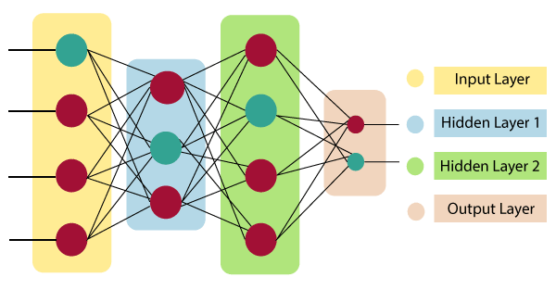

ANN – Artificial Neural Network
An ANN is based on a collection of connected units or nodes called artificial neurons, which loosely model the neurons in a biological brain.
Traditional statistical models that include exponential smoothing, moving average, and ARIMA make its prediction linear. Today, Support Vector Machines (SVM) and Artificial Neural Networks (ANN) are widely used to predict stock price movements.

Slide 6
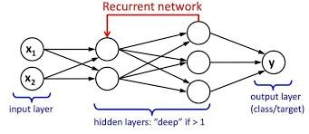
RNN – Recurrent Neural Network
RNN is a class of ANN where connections are established based on directed graphs along a temporal sequence.
This makes them applicable to tasks such as unsegmented, connected handwriting recognition or speech recognition.
It saves statistics required for its future use. If the prediction is wrong, the getting to know price is taken into consideration to make small changes. Hence, making it progressively closer to making the proper prediction in the course of the backpropagation.

Slide 7
LSTM – Long-Short Term Memory
“LSTMs” – are a special kind of RNN, capable of learning long-term dependencies.
LSTMs are explicitly designed to avoid the long-term dependency problem.
All recurrent neural networks have the form of a chain of repeating modules of neural network. In standard RNNs, this repeating module will have a very simple structure.
LSTMs also have this chain like structure, but the repeating module has a different structure. Instead of having a single neural network layer, there are four, interacting in a very special way.
The LSTM module is composed of a cell, a data door, a front door and a door with a view. The cell collects values over arbitrary time intervals, and the three inputs manipulate the development of records inside and out of the cell.

Slide 8
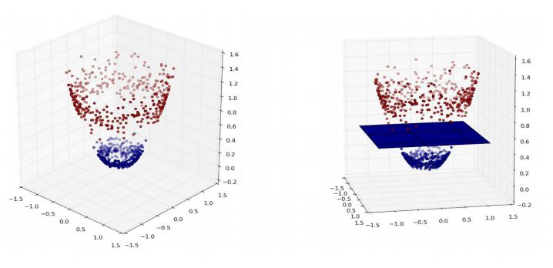
SVM – Support Vector Machine
SVM or Support Vector Machine is a linear model for classification and regression problems and outliers detection.
The idea of SVM is simple: The algorithm creates a line or a hyperplane which separates the data into classes.
In classification problems there are a set number of outputs that a feature set can be labeled as, whereas the output can take on continuous values in regression problems.
The linear separability of the data plays a significant role in deciding the degree of tolerance in SVM.

Slide 9
WHAT ARIMA STANDS FOR?
ARIMA is an acronym that stands for Autoregressive Integrated Moving Average.
AR: Autoregression - A model that uses the dependent relationship between an observation and some number of lagged observations.
I: Integrated - The use of differencing of raw observations (e.g., subtracting an observation from an observation at the previous time step) in order to make the time series stationary.
MA: Moving Average - A model that uses the dependency between an observation and a residual error from a moving average model applied to lagged observations.

Slide 10
PARAMETERS OF ARIMA
The parameters of the ARIMA model are defined as follows:
p: The number of lag observations included in the model, also called the lag order.
d: The number of times that the raw observations are differenced, also called the degree of differencing.
q: The size of the moving average window, also called the order of moving average.

Slide 11
STEPS FOR ARIMA IMPLEMENTATION
The general steps to implement an ARIMA model are –
Load the data: The first step for model building is of course to load the dataset.
Pre-processing: Depending on the dataset, the steps of pre-processing will be defined. This will include creating timestamps, converting the type of date/time column, making the series univariate, etc.
Make series stationary: In order to satisfy the assumption, it is necessary to make the series stationary. This would include checking the stationarity of the series and performing required transformations, i.e., bringing the p-value < 0.5.

Slide 12
Determine the p and q values: Read the values of p and q from the plots in the previous step.
Determine d-value: For making the series stationary, the number of times the difference operation was performed will be taken as the d value.
Fit ARIMA model: Using the processed data and parameter values we calculated from the previous steps, fit the ARIMA model.
Predict values on validation set: Predict the future values.
Calculate RMSE: To check the performance of the model, check the RMSE value using the predictions and actual values on the validation set.

Slide 13
Base Paper 1
The “Forecasting of demand using ARIMA model” paper used four parameters namely AIC (Akaike’s Information Criterion), and SBC (Schwarz’s Bayesian Criterion), variance and maxi-mum likelihood. The data taken is for food company and prediction for its future demand is made.
They used SPSS time series module and a fast maximum likelihood estimation algorithm The aforementioned algorithms were used to find values of the four parameters for different models like (1,1,1), (1,0,1) etc. On which they have based their predictions.
The ARIMA model (1, 0, 1) is selected because all the coefficients are significantly optimized than any other models taken into consideration.
The IBM SPSS Forecasting was used to then obtain the prediction based on the best parameters selected which had the best optimized values for the 4 parameters from the list of all permuted values P, D, Q i.e. (1, 0, 1) was selected.

Slide 14
Base Paper 2
ARIMA Model in Predicting Banking Stock Market Data
For predicting, the ARIMA model was used to banking stock market data in this article. The results are obtained using the MINTAB software. In the period 1993 to 2017, 2000 observations were gathered for each variable from associated databases.
Because several ARIMA models can be created for one column of data using different values of p, d, and q, RMSE is chosen as a criterion for finding the fitting ARIMA model. As a result, the fitted ARIMA model has a lower RMSE.
They have concluded on these observations:
1) The values of p, d, and q are between 0 and 2 solely because these values cannot be negative, and they should not be greater than 2 otherwise the parameter estimation will be useless.
2) The RMSE is set between 4.00 and 5.00 depending on the dataset. As a result, after utilizing the program to construct the dataset, ARIMA (1,1,2) was found to be the best with an RMSE of 1.4.
3) In some circumstances, the ARIMA model is not fitted, indicating that the dataset cannot be estimated, and this should be discarded.

Slide 15
Limitations
Only linear predictions are cultivated.
This method can be applied and suitable for cases of the high-technology market especially for the banks since it gives a significant indicator for the future but is inefficient for not so tightly bounded time series data.
There are many factors for different types of datasets to be considered which if taken wrongly may result a varied unrelated misleading output/prediction.

Slide 16
Future scope
This strategy can be used and is appropriate for high-tech market scenarios, particularly for banks, because it provides a substantial indicator for the future.
The approach was designed for short-term forecasting and is not suitable for long-term forecasting.
Other forecast horizons for stock market data, such as industrial data, can be investigated in the future. Creating new models that combine qualitative and quantitative methodologies to generate accurate forecasts and improve forecast accuracy in the future.
Testing it with a neural network technique and compare it to ARIMA's results to see if the ANN's power in future prediction can be confirmed. In addition, creating an ARIMA-radial basis function (RBF) combination can help achieve high accuracy.

Slide 17
Thank you

